Slide 1
Artificial Intelligence Course Project
DeepFake Detector
AI-Powered Multimedia Authenticity Analysis
University
Department
University of Layyah
BS IT 6th A (Morning)
Date
Course
June 2026
Artificial Intelligence
BS IT 6th A (Morning) • University of Layyah
Academic Year 2025-2026

Slide 2
Team Members
Collaborative AI Research & Development Team
Sundas Iqbal
Laiba Fayyaz
BSITM-A-23-31
BSITM-A-23-25
Co-developer & Research Lead
Co-developer & Technical Implementation
Collaborative Focus: Joint development of the DeepFake detection system, combining expertise in deep learning, computer vision, and natural language processing to create a multi-modal authenticity analysis platform.

Slide 3

Problem Statement
The Critical Threat of DeepFakes to Digital Trust
Critical Digital Threat
DeepFakes represent a critical threat to digital trust , leveraging advanced AI to create hyper-realistic synthetic media that is increasingly indistinguishable from authentic content.
Malicious Applications
Misinformation
Financial Fraud
Identity Theft
Fake news
Scams
Impersonation
The Solution
A multi-modal, behavior-aware approach is essential—combining visual analysis with emotional consistency checks to detect sophisticated deepfakes.
Limitations of Current Detectors
Existing solutions focus only on visual artifacts, but modern AI generates highly realistic fakes that bypass standard pixel-level checks. This creates a critical detection gap .
Research Gap: Current detectors lack cross-modal analysis, creating vulnerability to next-generation deepfakes.

Slide 4
Project Objectives
Five Strategic Goals for Comprehensive DeepFake Detection
01
DeepFake Detection
02
EfficientNet-B0 CNN
05
Streamlit Web Interface
Detect deepfake images and videos using advanced AI algorithms with high accuracy and reliability.
Implement EfficientNet-B0 CNN for visual artifact detection, optimized for facial analysis.
Deploy an interactive web interface using Streamlit for real-time deepfake detection.
Multi-modal media support
State-of-the-art architecture
User-friendly design
Real-time processing
Comprehensive reporting
★ ECF Module
04
Grad-CAM Explainability
Introduce Emotion-Consistency Forensics to cross-check facial emotion with voice tone.
Provide explainability using Grad-CAM heatmaps to visualize detection evidence.
Unified Goal
Novel behavioral analysis
Transparent AI decisions
Create a comprehensive, multi-modal detection system that addresses current limitations.
Integration Strategy: All five objectives work synergistically—visual CNN detects artifacts, ECF catches emotional inconsistencies, Grad-CAM provides transparency, and Streamlit delivers accessibility.

Slide 5
System Architecture
End-to-End Multi-Modal DeepFake Detection Pipeline
INPUT
Image/Video Upload via Web UI
PREPROCESSING
MTCNN Face Detection • Frame Extraction • Audio Separation
Parallel Processing
Visual Analysis
★ ECF Module
EfficientNet-B0 CNN
FER + Whisper + VADER
Detects blending boundaries, texture inconsistencies
Cross-checks facial emotion with voice sentiment
Output
Output
Visual Fake Score
Inconsistency Score
FUSION
Weighted Average of Visual + ECF Scores
OUTPUT
Final Verdict • Grad-CAM Heatmap • ECF Report

Slide 6
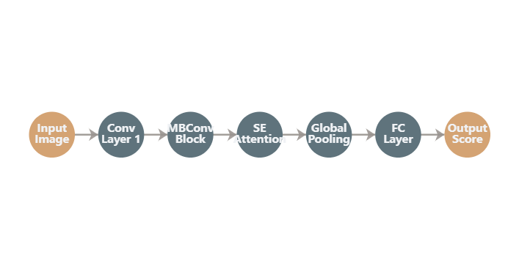
AI Algorithm 1 - Visual CNN
EfficientNet-B0 for Visual Artifact Detection
Model Architecture
Architecture Diagram
EfficientNet-B0
Pre-trained on ImageNet, fine-tuned for deepfake detection
Training Datasets
FaceForensics++ and DFDC (DeepFake Detection Challenge)
Detection Capabilities
Blending Boundaries
Detects seams between original and synthetic regions
Texture Inconsistencies
Identifies unnatural skin texture and lighting artifacts
Facial Anomalies
Spots irregularities in eyes, teeth, and hair regions
Why EfficientNet-B0?
Compound scaling optimizes depth, width, and resolution
Performance
Superior accuracy with fewer parameters than ResNet
Achieves high accuracy in distinguishing real vs. fake faces.
Efficient for real-time deployment on standard hardware
Technical Note: EfficientNet-B0 uses depthwise separable convolutions and squeeze-and-excitation optimization for superior feature extraction.

Slide 7
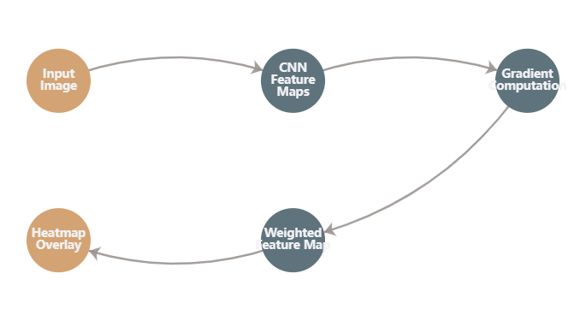
AI Algorithm 2 - Grad-CAM
Gradient-weighted Class Activation Mapping for Explainability
How Grad-CAM Works
Grad-CAM Visualization Process
1
Forward Pass
Image passes through CNN to generate predictions
2
Gradient Computation
Calculate gradients of target class w.r.t. feature maps
3
Weighted Combination
Global average pooling creates importance weights
4
Heatmap Generation
Overlay heatmap on original image for visualization
Heatmap Interpretation
Key Benefits
Red Regions
Yellow Regions
Blue Regions
Transparency: Makes AI decisions interpretable
Strong evidence of manipulation
Moderate suspicion areas
Low manipulation evidence
Trust: Users can verify detection rationale
Debugging: Helps identify model weaknesses
Compliance: Meets explainable AI requirements
Technical Implementation: Grad-CAM uses the gradients of any target concept flowing into the final convolutional layer to produce a coarse localization map highlighting important regions.

Slide 8
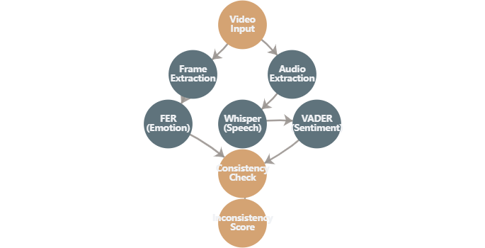
★ Unique Feature - ECF Module
Emotion-Consistency Forensics for Cross-Modal Analysis
ECF Processing Pipeline
ECF Module Architecture
1
FER - Facial Emotion Recognition
Extracts facial emotion from video frames (happy, sad, angry, etc.)
2
Whisper - Speech Transcription
Transcribes speech to text with high accuracy
3
VADER - Sentiment Analysis
Analyzes emotional sentiment of transcribed text
4
Cross-Modal Consistency Check
Compares facial emotion vs. voice sentiment
Example Detection
Why It's Unique
Smiling Face
Angry Words
DeepFakes synthesize video and audio separately, causing emotional mismatches that standard detectors miss.
FER: Happy
VADER: Negative
⚠ High Inconsistency Score
First behavioral forensics approach
Potential DeepFake Detected
Detects sophisticated AI-generated fakes
Complements visual detection methods
Innovation: ECF represents a paradigm shift from pixel-level analysis to behavioral forensics, addressing the fundamental vulnerability in current detection systems.

Slide 9
Technology Stack
Comprehensive Technology Ecosystem for DeepFake Detection
Core Language
AI Framework
CNN Model
Python 3.10
PyTorch
EfficientNet-B0
Primary development language
Deep learning framework
via timm library
Rich AI/ML ecosystem
Dynamic computation graphs
Compound scaling optimization
Extensive libraries
Excellent debugging tools
Pre-trained on ImageNet
Strong community support
Strong research community
State-of-the-art accuracy
Face Detection
Emotion
Speech
MTCNN
FER
OpenAI Whisper
Multi-task Cascaded CNN
TensorFlow/Keras backend
Automatic speech recognition
Real-time detection
7 emotion classes
Multi-language support
High accuracy
Real-time analysis
Robust to noise
Sentiment
Explainability
Interface
VADER
Native Grad-CAM
Streamlit
Valence Aware Dictionary
Class activation mapping
Interactive web application
Social media optimized
Heatmap visualization
Rapid development
Real-time scoring
Model interpretability
Real-time interaction

Slide 10
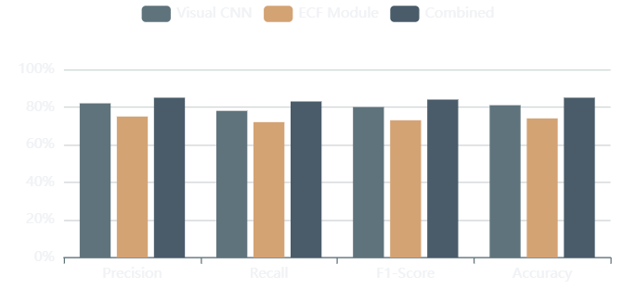
Results & Demo
Performance Metrics and System Demonstration
Model Performance
Performance Overview
Test Accuracy
Visual Detection
~80%+
✓
On test datasets
Artifacts detected
Successful Detections
Visual Artifacts in Images
Blending boundaries, texture inconsistencies, facial anomalies
Cross-Modal Consistency in Videos
Demo Video
Emotion-sentiment mismatches via ECF module
Streamlit App Features
Image/Video upload
Grad-CAM heatmaps
Watch System Demo
Confidence scores
ECF reports
Complete walkthrough of detection capabilities
Note: Screenshots of the Streamlit application showing image detection with Grad-CAM heatmap and video ECF report are available in the project documentation.

Slide 11
Limitations
Current Constraints and Areas for Improvement
Audio Dependency
Processing Time
ECF requires clear audio and fails on silent videos or those with heavy background noise.
Processing on CPU is high; GPU is recommended for real-time video analysis.
Facial Occlusions
Mitigation Strategies
FER struggles with extreme facial angles or occlusions like masks and glasses.
Audio Enhancement
Implement noise reduction preprocessing
Multi-Angle Training
Train FER on occluded and angled faces
False Positives
Contextual Analysis
Real emotional acting (e.g., sarcasm) can trigger false positives in the ECF module.
Add contextual cues to reduce false positives
Hardware Optimization
GPU acceleration and model quantization
Research Insight: These limitations represent active research areas in the deepfake detection community, providing clear directions for future development.

Slide 12
Conclusion & Future Work
Project Summary and Research Directions
Key Achievements
Future Work
Multi-Algorithm System
1
Larger Datasets
Successfully developed a comprehensive DeepFake detection system
Train on more diverse and comprehensive datasets
Novel ECF Module
2
Real-Time Webcam
Introduced behavioral forensics dimension for cross-modal analysis
Support real-time detection via webcam feed
High Accuracy
3
Advanced Audio Detection
Achieved ~80%+ accuracy on test datasets
Integrate dedicated audio deepfake detectors
Interactive Interface
4
Model Optimization
Deployed user-friendly Streamlit web application
Improve processing speed and reduce false positives
Research Impact
This project demonstrates the feasibility of multi-modal deepfake detection and opens new research directions in behavioral forensics for multimedia authenticity.
Thank You
Questions & Discussion
BS IT 6th A (Morning) • University of Layyah
Contact for collaboration
Project repository available
May 2026 • Artificial Intelligence Course

